Slide 1
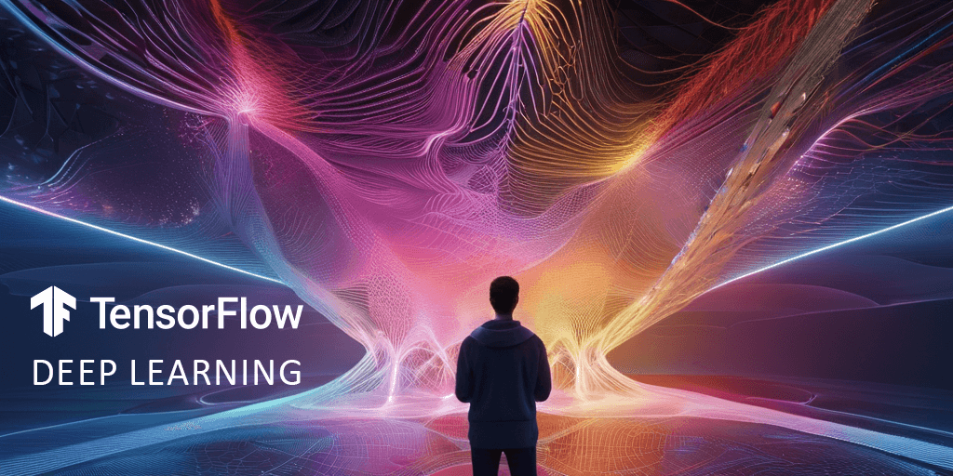
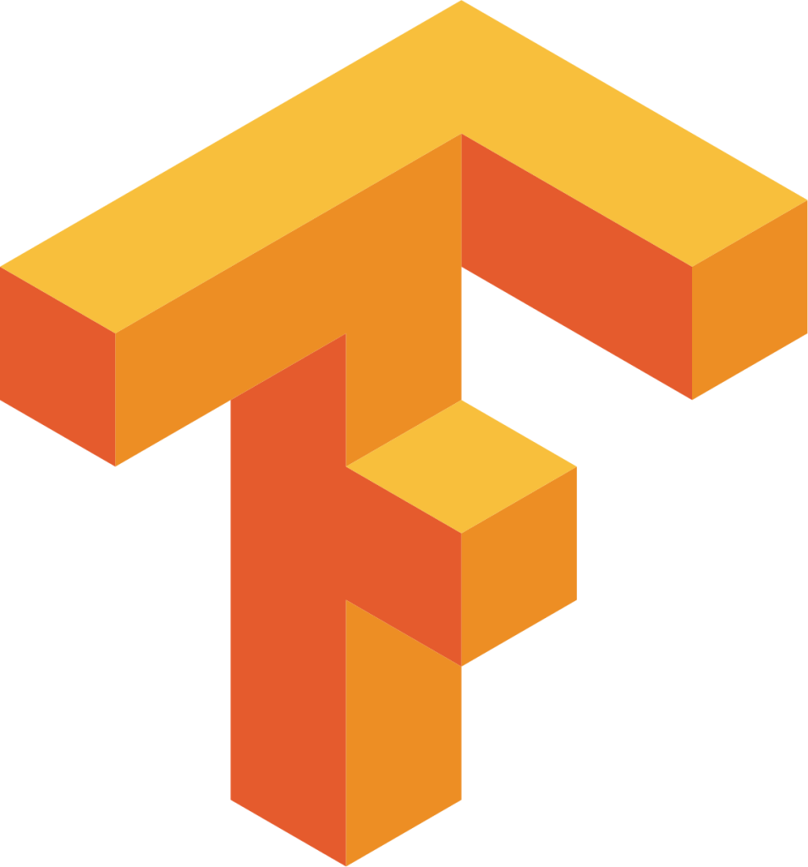
Team: FUTURE AI WIZARDS - “A GIANT LEAP FOR MANKIND AND AI”

Slide 2
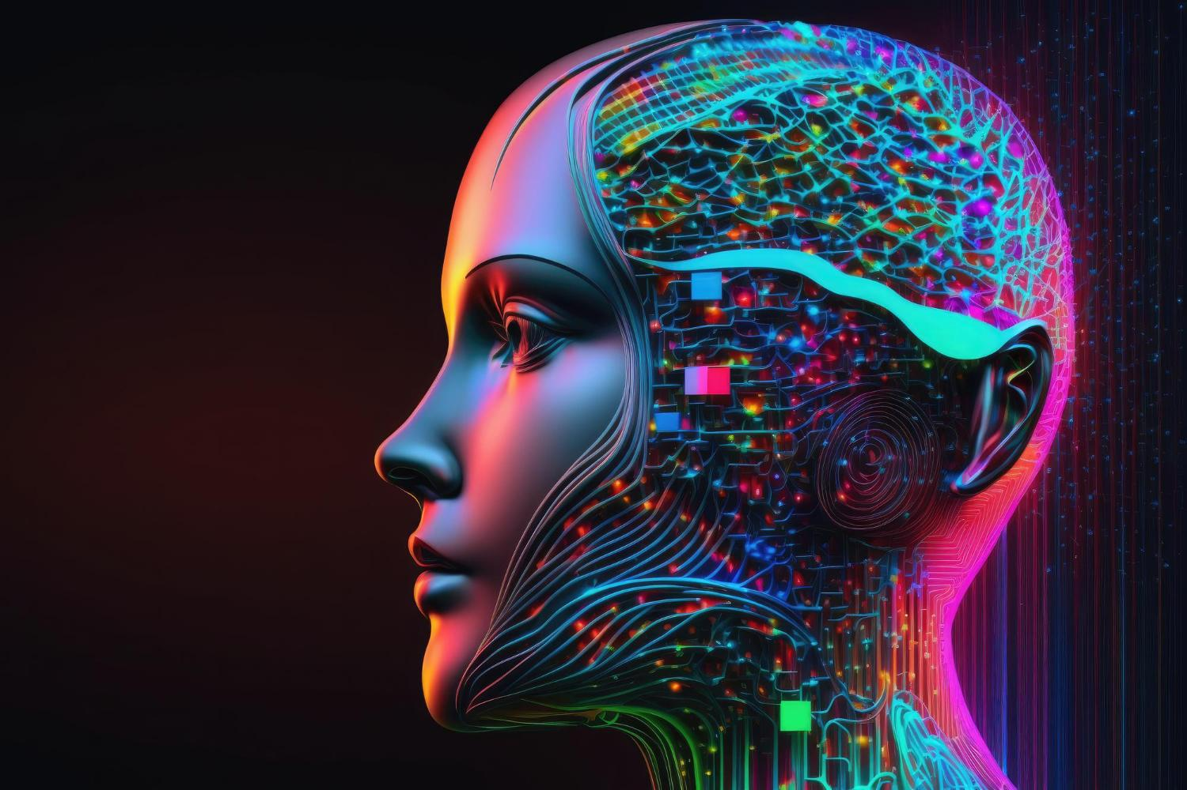
WHAT IS TENSORFLOW?
TensorFlow is designed to be a flexible and efficient platform for developing and training machine learning models. It provides a comprehensive ecosystem of tools, libraries, and community resources that support various machine learning tasks. TensorFlow supports both traditional machine learning methods and deep learning techniques.
TensorFlow's origins can be traced back to Google's internal deep learning infrastructure. The company decided to open-source the framework to encourage collaboration and innovation in the field of machine learning. The first version, TensorFlow 0.6, was released to the public in 2015.
The primary purpose of TensorFlow is to simplify the process of developing and deploying machine learning models. It caters to a wide range of applications, including image and speech recognition, natural language processing, recommendation systems, and more.
TensorFlow's versatility allows researchers, developers, and businesses to implement machine learning solutions across various domains. It supports model deployment on different platforms, including cloud services and edge devices, making it a valuable tool for both research and production environments.

Slide 3
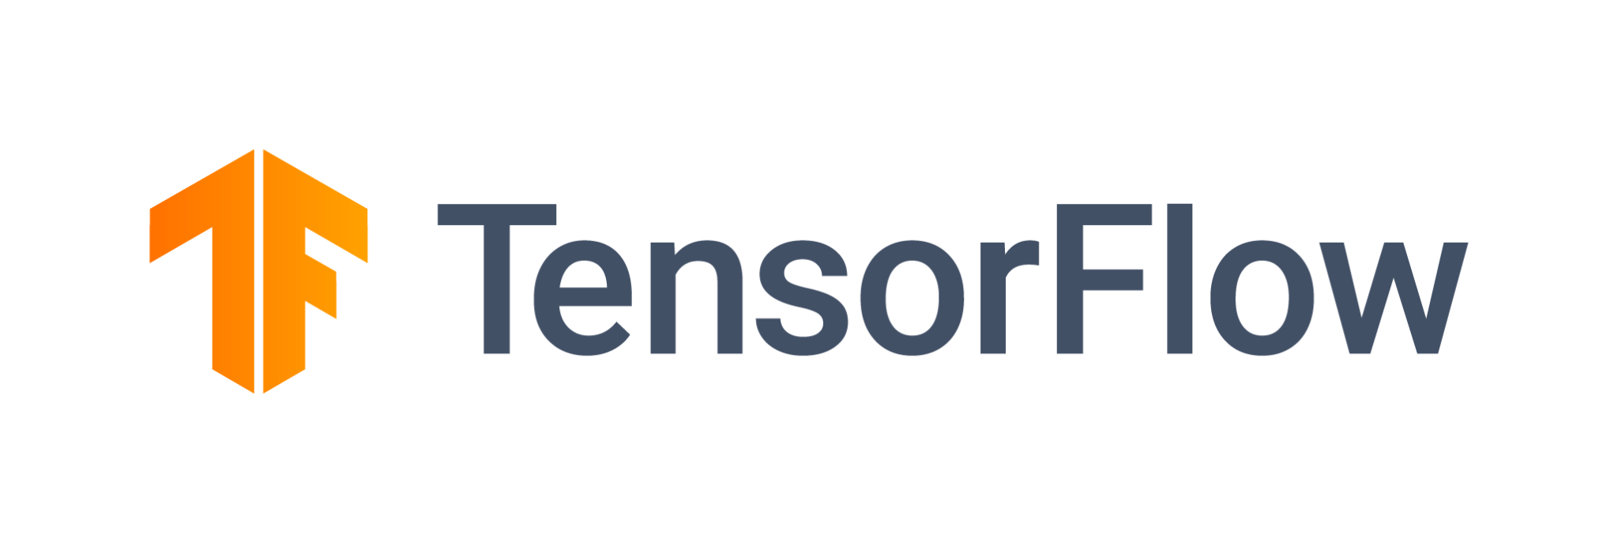
KEY FEATURES
Flexible Deployment
GPU Support
Highly Scalable
Can Perform Complex Numeric Computations
Computational graphs
Keras Integration
TensorBoard
Versatility
Models can be built easily using Neural Networks.
Community & Documentation
Contains pre-trained models and datasets
Comprehensive Ecosystem
Notes:
One of the key features is use of computational graphs: This allows for parallelism and optimization, making it suitable for large-scale distributed training across multiple CPUs or GPUs.
TensorFlow is an open-source machine learning framework, allowing users to access and modify the source code according to their needs.
TensorFlow seamlessly integrates with the high-level neural networks API, Keras, providing a user-friendly interface for building and training deep learning models.
It supports a wide range of machine learning tasks, including but not limited to deep learning, neural networks, and numerical computations.
The latest version, TensorFlow 2.x, emphasizes ease of use and simplicity. It includes features like eager execution and a more intuitive API.
TensorFlow can scale from running on a single device to distributed computing across multiple devices and large-scale clusters
Models developed in TensorFlow can be deployed on various platforms, including desktops, servers, mobile devices, and the cloud.
TensorFlow provides a comprehensive ecosystem with tools and libraries for tasks such as data preprocessing, model visualization, and deployment.
TensorFlow includes TensorBoard, a tool for visualizing and analyzing machine learning models. It helps in monitoring metrics, visualizing the graph, and debugging.
TensorFlow can leverage the power of GPUs to accelerate training processes, making it suitable for handling large datasets and complex models.
TensorFlow 2.x incorporates AutoGraph, a feature that automatically converts Python code into TensorFlow graph operations. tf.function allows users to create highly efficient TensorFlow functions from Python code.
Complex Numeric Computations can be done: As the input dataset is huge, the mathematical computations/calculations can be done easily.
Models can be developed easily: TensorFlow supports high-level APIs, through which Machine Learning models can be built easily using Neural Networks.
One of the key features of TensorFlow is its use of computational graphs to represent and execute machine learning models. But it has many other features that set it apart

Slide 4



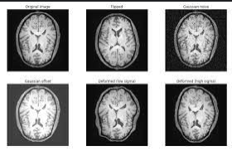
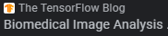
REAL WORLD APPLICATIONS
Healthcare and Medicine:
Medical Image Analysis: TensorFlow is used to process and analyze medical images for disease detection, such as identifying tumors in MRI or CT scans.
Drug Discovery: Leveraging TensorFlow for computational chemistry, it aids in discovering molecular structures that could lead to potential drugs.
Finance:
Algorithmic Trading: TensorFlow can be used to build models for predicting stock prices and making automated trading decisions.
Credit Scoring: Banks and financial institutions use it for credit scoring by analyzing customers' financial history and behavior.
Automotive and Transportation:
Autonomous Vehicles: TensorFlow is crucial in developing algorithms for self-driving cars, including object detection and decision making.
Traffic Prediction and Management: Analyzing traffic patterns and predicting congestion, helping in urban planning and traffic management.
Retail and E-commerce:
Recommendation Systems: Personalizing user experience on e-commerce sites by recommending products based on past behavior.
Inventory Management: Predicting inventory demand to optimize stock levels.
Manufacturing & Agriculture:
Predictive Maintenance: Predicting when machines or components are likely to fail, thus reducing downtime and maintenance costs.
Crop Disease Detection: Identifying diseases in crops using image analysis.
Yield Prediction: Predicting crop yields based on various factors like weather conditions, soil quality, etc.
Entertainment and Media:
Content Recommendation: For services like Netflix or YouTube, suggesting content based on viewing history and preferences.
Music and Voice Recognition: Used in voice-assistant technologies and for generating music recommendations.
TensorFlow In Action:

Slide 5
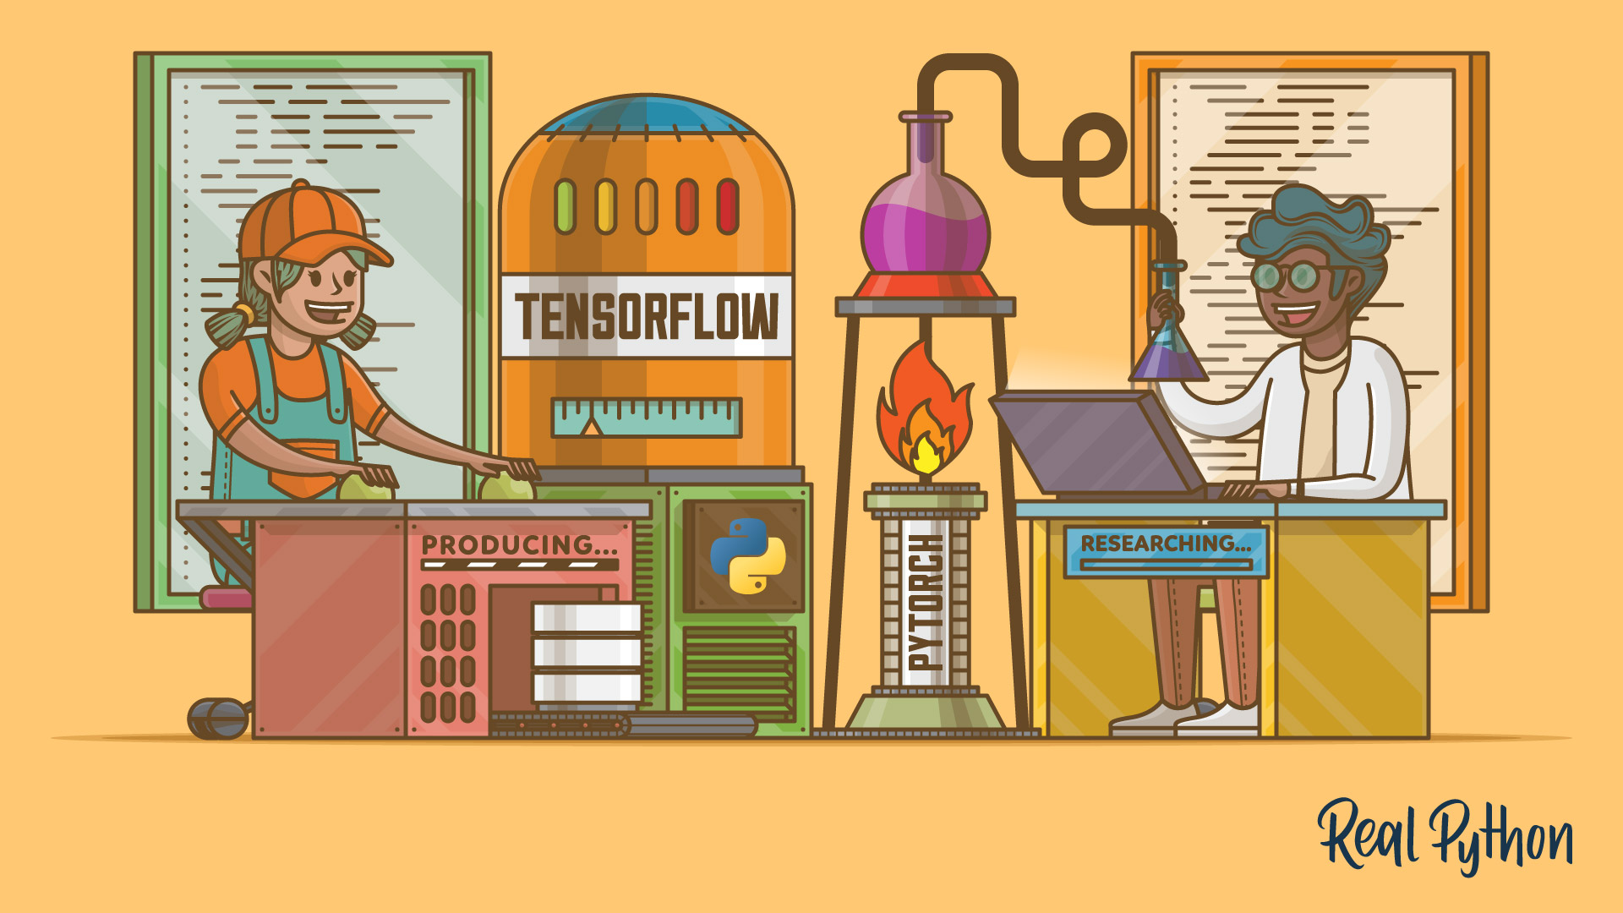

Slide 6
Tools Comparison
TensorFlow and Pytorch are two popular (open-source) frameworks that are used in both commercial and academic realms. The two frameworks share many features such as computing on numerical data and graphical representation of those calculations, but there are differences between the two in developer experience. The table below outlines some of the major differences.
Feature | TensorFlow | PyTorch
Graph Definition | Static | Dynamic
Debugging | Difficult | Easy
Deployment | Easy | Difficult
Community | Large and very active | Gowing and active

Slide 7

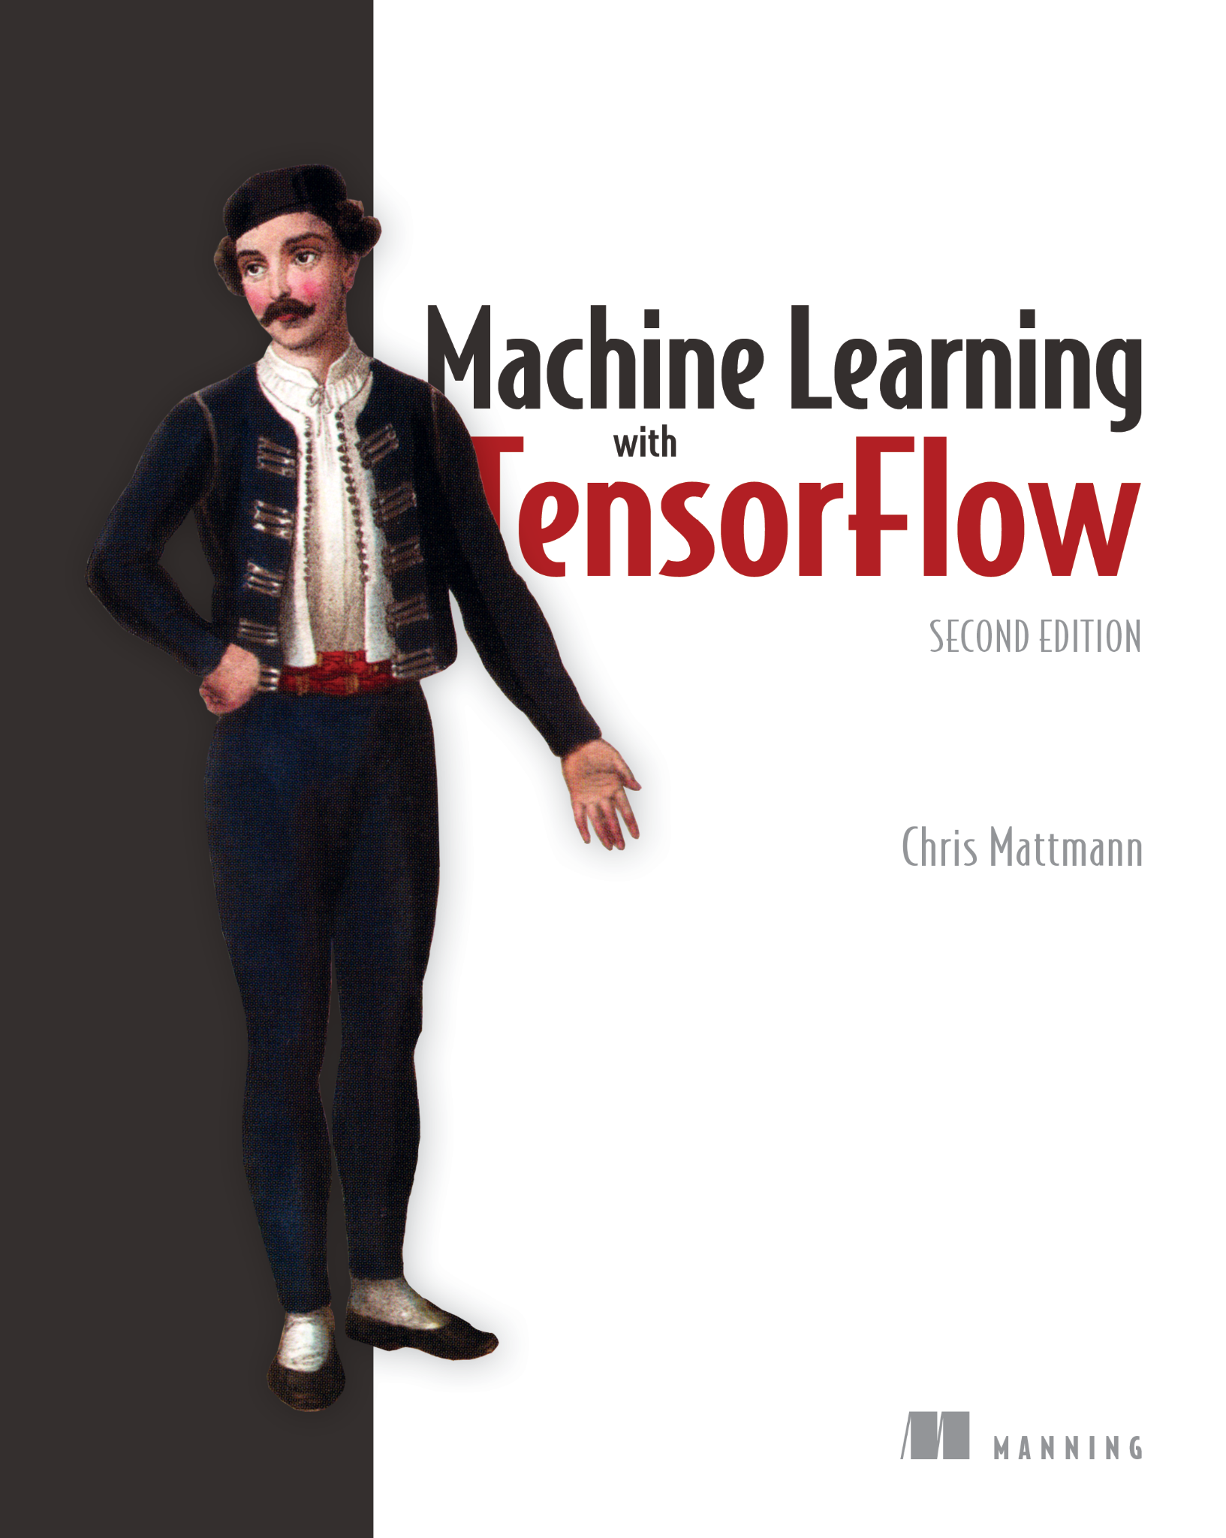
CONCLUSION
TensorFlow originated from Google's internal needs for scalable and efficient machine learning infrastructure. Its development has focused on providing a flexible framework for building a variety of machine learning models, and its purpose is to empower the broader community with tools for advancing AI research and applications.
TensorFlow's versatility allows researchers, developers, and businesses to implement machine learning solutions across various domains. It supports model deployment on different platforms, including cloud services and edge devices, making it a valuable tool for both research and production environments.

Slide 8
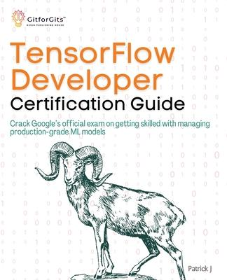
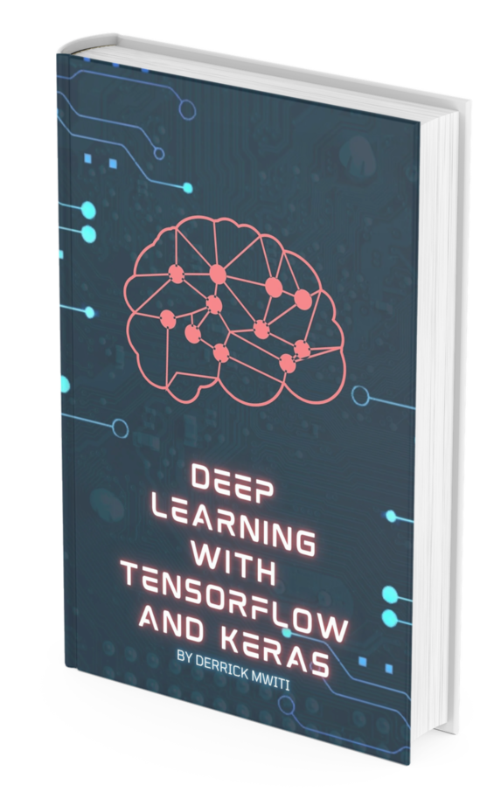
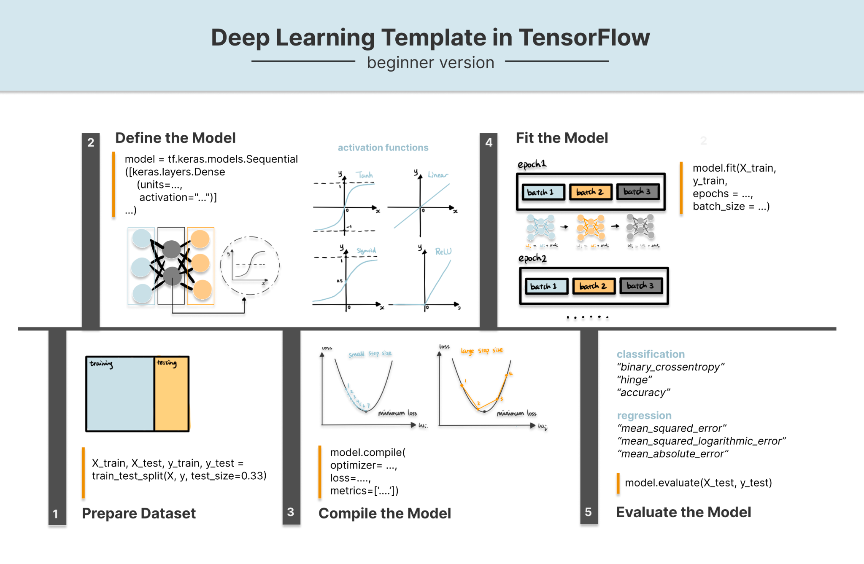
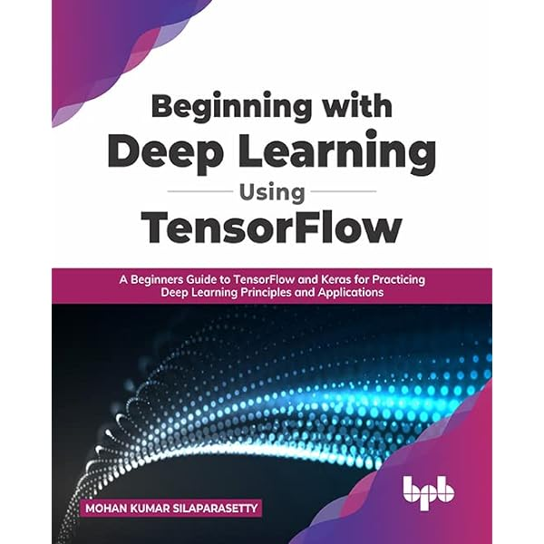

TENSORFLOW RESOURCES
https://github.com/tensorflow/

Slide 9
REFERENCES:
Causevic, D. (2017, November 29). Getting started with TensorFlow: A machine learning tutorial. Toptal Engineering Blog. https://www.toptal.com/machine-learning/tensorflow-machine-learning-tutorial
Doshi, Prid (2023, July 17). TensorFlow vs. PyTorch: Which Deep Learning Framework is Right for You? stackify.com. https://stackify.com/tensorflow-vs-pytorch-which-deep-learning-framework-is-right-for-you/
GeeksforGeeks. (2021, May 27). Why TensorFlow is so popular - TensorFlow features. GeeksforGeeks. https://www.geeksforgeeks.org/why-tensorflow-is-so-popular-tensorflow-features/
Google. (n.d.). Introduction to TensorFlow | Machine Learning | Google for Developers. https://developers.google.com/machine-learning/crash-course/first-steps-with-tensorflow/toolkit
Google Research. (n.d.). TensorFlow: A system for large-scale machine learning. https://research.google/pubs/tensorflow-a-system-for-large-scale-machine-learning/
Johns, Ray (Unknown). PyTorch vs TensorFlow for Your Python Deep Learning Project. realpython.com. https://realpython.com/pytorch-vs-tensorflow/
Kurama, Vihar (2023, March 07). PyTorch vs. TensorFlow: Key Differences to Know for Deep Learning. builtin.com. https://builtin.com/data-science/pytorch-vs-tensorflow

